Slide 1
Logic Design
Chapter 6
Registers and Counters

Slide 2
Overview
Clocked sequential circuits
a group of flip-flops and combinational gates
connected to form a feedback path
Flip-flops + Combinational gates
(essential) (optional)
Register:
a group of flip-flops
gates that determine how the information is transferred into the register
Counter:
a register that goes through a predetermined sequence of states
2
Notes:
credential:
bring a computer
die photo
wafer
:
This can be an hidden slide. I just want to use this to do my own planning.
I have rearranged Culler’s lecture slides slightly and add more slides. This covers everything he covers in his first lecture (and more) but may
We will save the fun part, “ Levels of Organization,” at the end (so student can stay awake): I will show the internal stricture of the SS10/20.
Notes to Patterson: You may want to edit the slides in your section or add extra slides to taylor your needs.

Slide 3
Registers

Slide 4
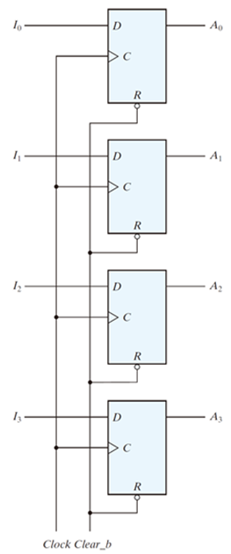
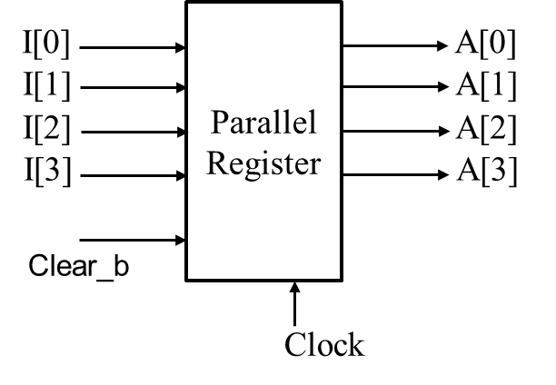
Register
A n-bit register
n flip-flops capable of storing n bits of binary information
i.e., 4-bit register
Load in parallel on clock transition
A clock edge applied to the C inputs of flip‐flops will load all four inputs in parallel
Asynchronous Clear
Clear_b goes to the active‐low R (reset) input of all four flip‐flops
4

Slide 5

Register Symbol
I[0]
Parallel
Register
A[0]
I[1]
A[1]
I[2]
A[2]
I[3]
A[3]
Clear_b
What if signals I[0]~I[3] arrive at different time, due to some combinational circuit delay?
Clock
Parallel
Register
I[3:0]
A[3:0]
Clear_b
Load
Clock
5

Slide 6
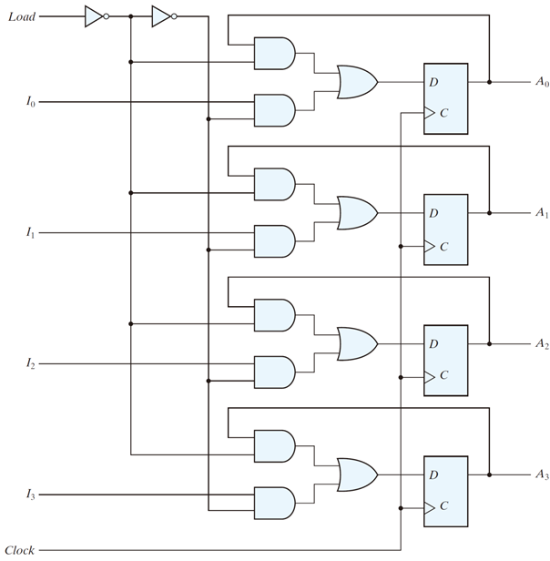
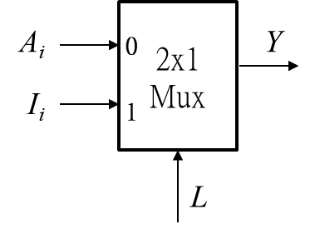
Register with Load Control
A₀
Load’
I₀
Load
Load = 1
new data loaded on next positive clock edge
Load = 0
old data reloaded on next positive clock edge
6

Slide 7
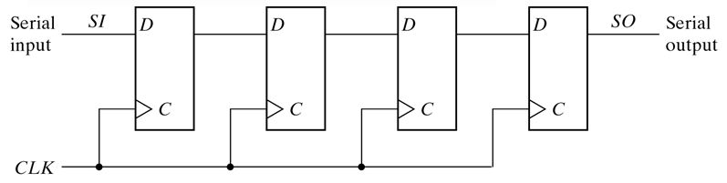
Shift Register
a register capable of shifting its binary information in one or both directions
Cascade chain of Flip-Flops
Serial in – Serial out, can also have parallel load / read
initial
1 0 1 1 0
CLK
1 1 0 1 1
CLK
1 1 1 0 1
CLK
1 1 1 1 0
7

Slide 8
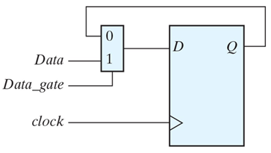
Practice Exercise
Practice Exercise 6.1
Draw the logic diagram of a circuit that suspends the clock action of a D flip-flop without gating its clock. Describe the behavior of the circuit.
Answer:
If Data_gate = 1, Data is transferred to Q with each active edge of clock. If Data_gate = 0, the value of Q is recirculated through the mux-flip-flop path, with the effect that clock appears to be suspended.
8

Slide 9
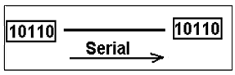
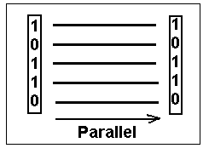
Parallel versus Serial
Serial communications is defined as
Provides a binary number as a sequence of binary digits, one after another, through one data line.
Parallel communications
Provides a binary number through multiple data lines at the same time.
9

Slide 10
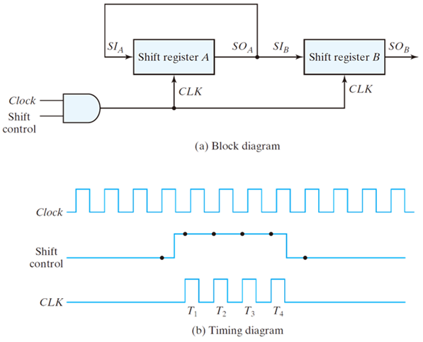
Serial Transfer from reg A to reg B
Data transfer one bit at a time
Data loopback for register A
Time
Initial value
After T1
After T2
After T3
After T4
Reg A
1011
1101
1110
0111
1011
Reg B
0011
1001
1100
0110
1011
10

Slide 11
Shift register application
Parallel-to-Serial conversion for serial transmission
Serial-to-Parallel conversion for data extraction
parallel outputs
Shift register
Shift register
Shift register
Shift register
parallel inputs
serial transmission
11

Slide 12
Universal Shift Register
Capability of a universal shift register:
A clear control to clear the register to 0.
A clock input to synchronize the operations.
A shift-right control to enable the shift right operation and the serial input and output lines associated w/ the shift right.
A shift-left control to enable the shift left operation and the serial input and output lines associated w/ the shift left.
A parallel-load control to enable a parallel transfer and the n parallel input lines associated w/ the parallel transfer.
n parallel output lines.
A control state that leaves the information in the register unchanged in the presence of the clock.
12

Slide 13
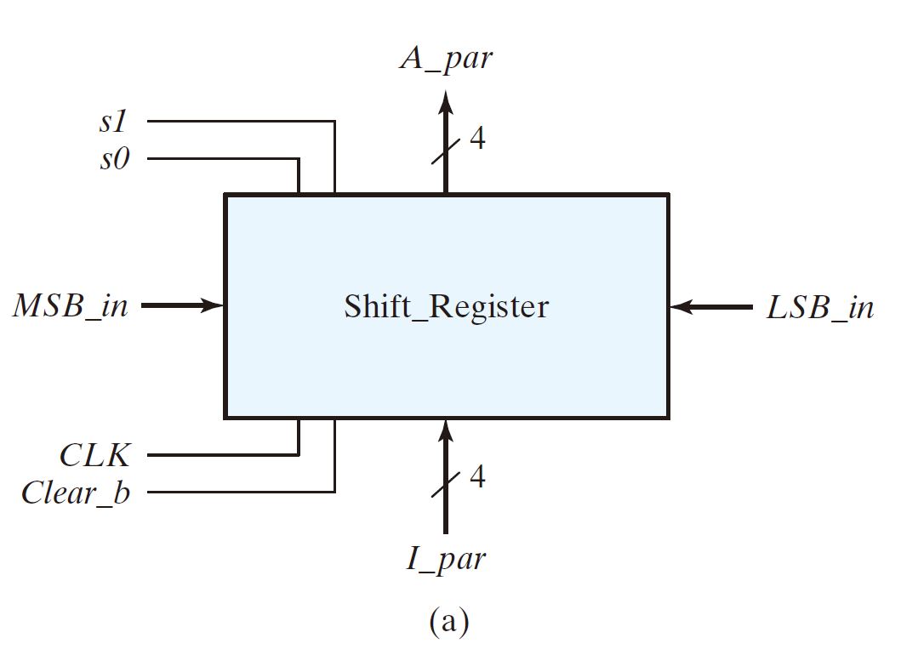

4-bit Universal Shift Register
s1 s0 register operation 0 0 No change 0 1 shift right 1 0 shift left 1 1 Parallel load
13

Slide 14
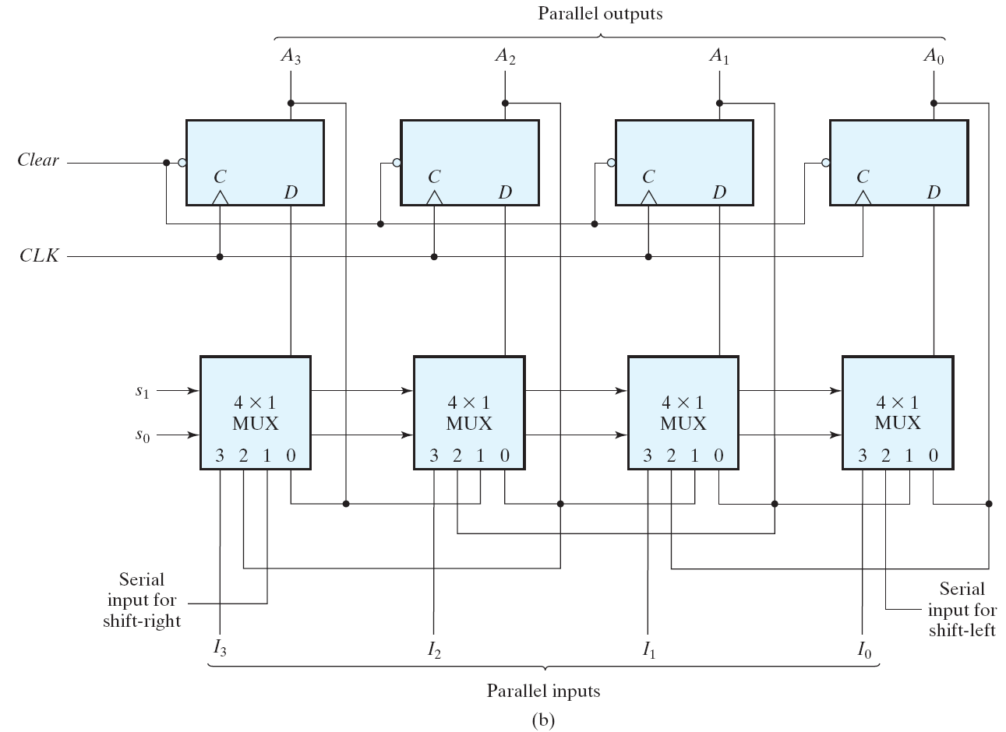
4-bit Universal Shift Register
s1 s0 register operation 0 0 No change 0 1 shift right 1 0 shift left 1 1 Parallel load
14

Slide 15
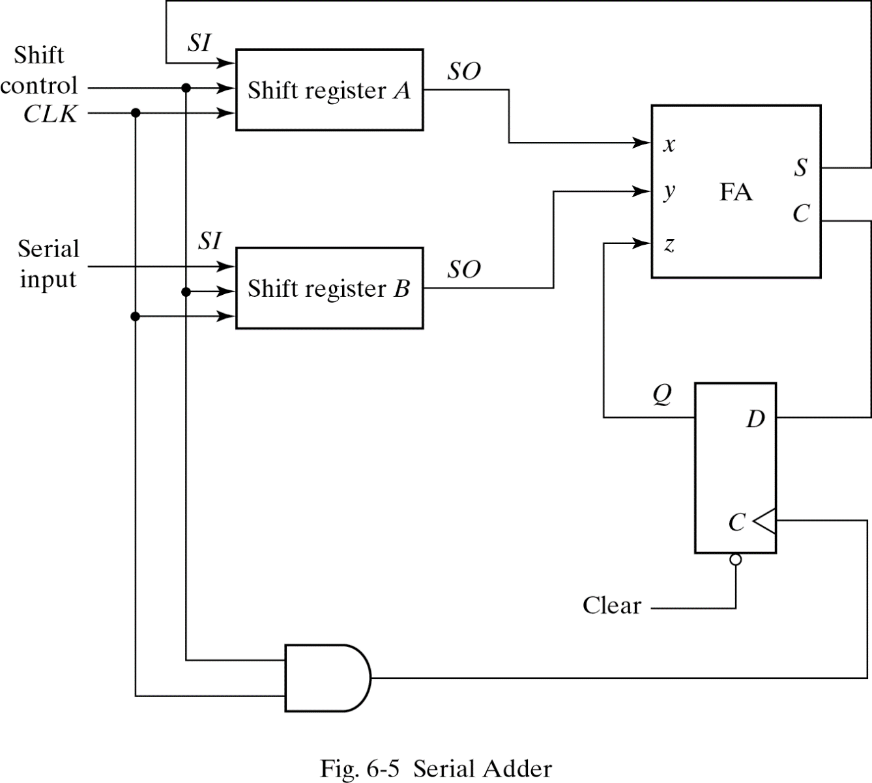
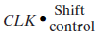
Serial Addition (D Flip-Flop)
Slower than parallel
Low cost
Only one full adder
Start with low-order bit addition
Shift control start/stop addition
carry (Q) is saved
Add multiple values.
New values placed in shift register B
( i.e. X + Y + Z )
15

Slide 16
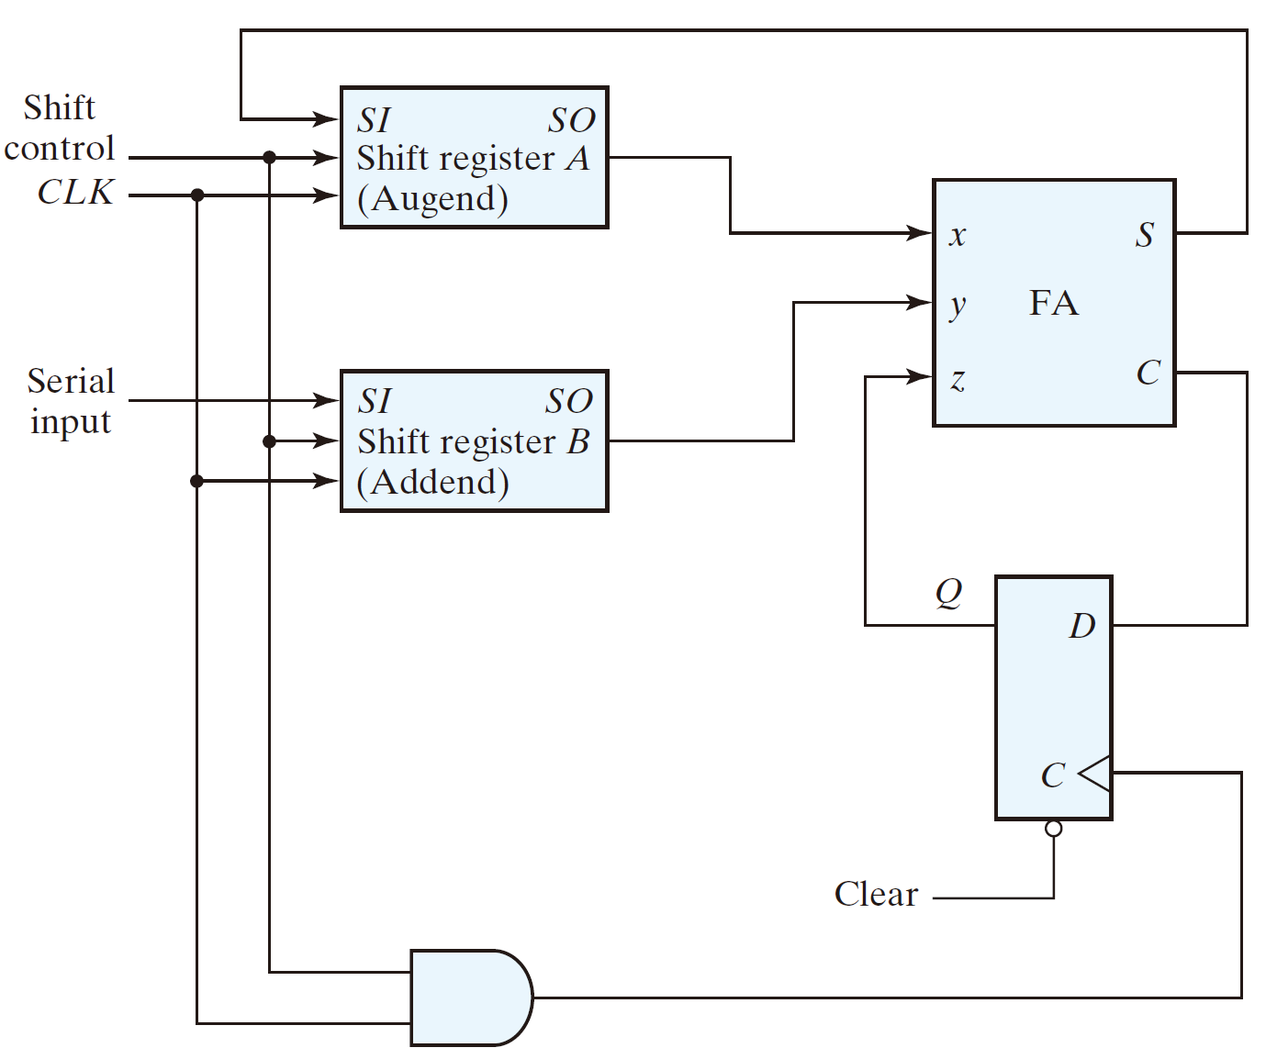
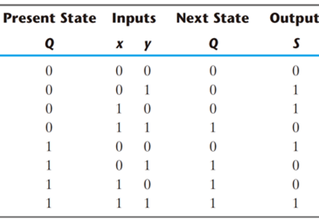
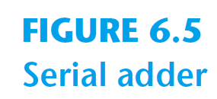
Serial Addition (D Flip-Flop)
0
0101
1
0011
0
We can analyze this serial adder as follows.
16

Slide 17
Serial Addition (D Flip-Flop)
0
0010
1
?001
1
17

Slide 18
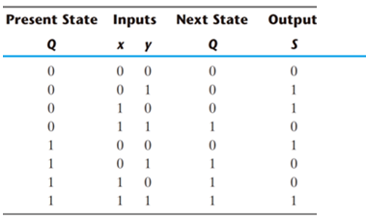
Serial Addition (D Flip-Flop)
Or, we can think of this circuit as a finite state machine, implemented with D Flip-flop.
Q(t)
Q(t+1)= D
D
S = x ⊕ y ⊕ Q
D = x y + xQ + yQ
(a full adder)
18

Slide 19
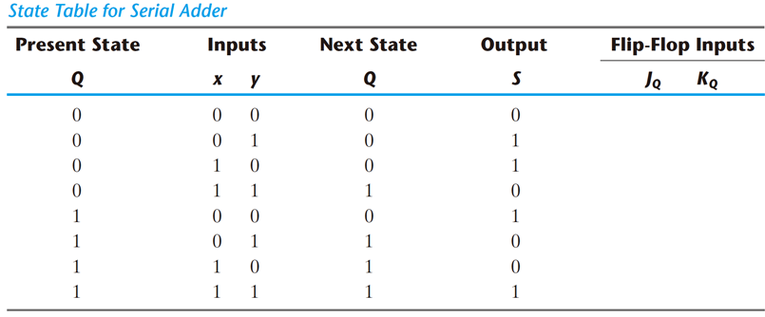
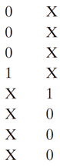
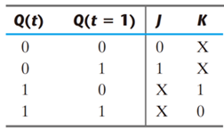
Serial Addition (JK Flip-Flop)
The serial adder can be implemented using JK FFs, too.
J_{Q} = x y
K_{Q} = x′ y′ = (x + y)′
S = x ⊕ y ⊕ Q
19

Slide 20
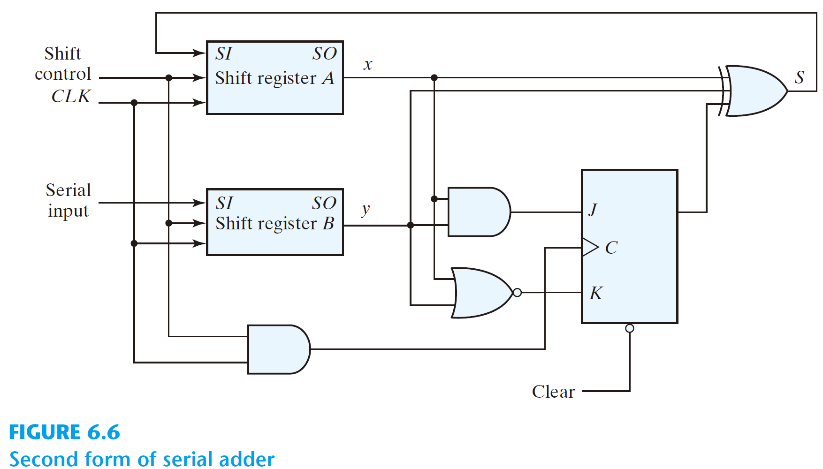
Serial Addition (JK Flip-Flop)
J_{Q} = x y
K_{Q} = x′ y′ = (x + y)′
S = x ⊕ y ⊕ Q
20

Slide 21
Summary
Shift registers can be combined together to allow for data transfer
Serial transfer used in modems and computer peripherals (e.g. mouse)
D flip flops allow for a simple design
Data clocked in during clock transition (rising or falling edge)
Serial addition takes less chip area but is slow
Universal shift register allows for many operations
The register is programmable.
It allows for different operations at different times
21
Notes:
credential:
bring a computer
die photo
wafer
:
This can be an hidden slide. I just want to use this to do my own planning.
I have rearranged Culler’s lecture slides slightly and add more slides. This covers everything he covers in his first lecture (and more) but may
We will save the fun part, “ Levels of Organization,” at the end (so student can stay awake): I will show the internal stricture of the SS10/20.
Notes to Patterson: You may want to edit the slides in your section or add extra slides to taylor your needs.

Slide 22
Counters

Slide 23
Counters
Counters are important components in computers
They increment or decrement by one in response to input
Two main types of counters
Ripple (asynchronous) counters
Synchronous counters
Ripple counters
Flip flop output serves as a source for triggering other flip flops
no common clock pulse (not synchronous)
Synchronous counters
All flip flops triggered by a common clock signal
Synchronous counters are more widely used in industry.
23
Notes:
credential:
bring a computer
die photo
wafer
:
This can be an hidden slide. I just want to use this to do my own planning.
I have rearranged Culler’s lecture slides slightly and add more slides. This covers everything he covers in his first lecture (and more) but may
We will save the fun part, “ Levels of Organization,” at the end (so student can stay awake): I will show the internal stricture of the SS10/20.
Notes to Patterson: You may want to edit the slides in your section or add extra slides to taylor your needs.

Slide 24
Ripple Counters

Slide 25
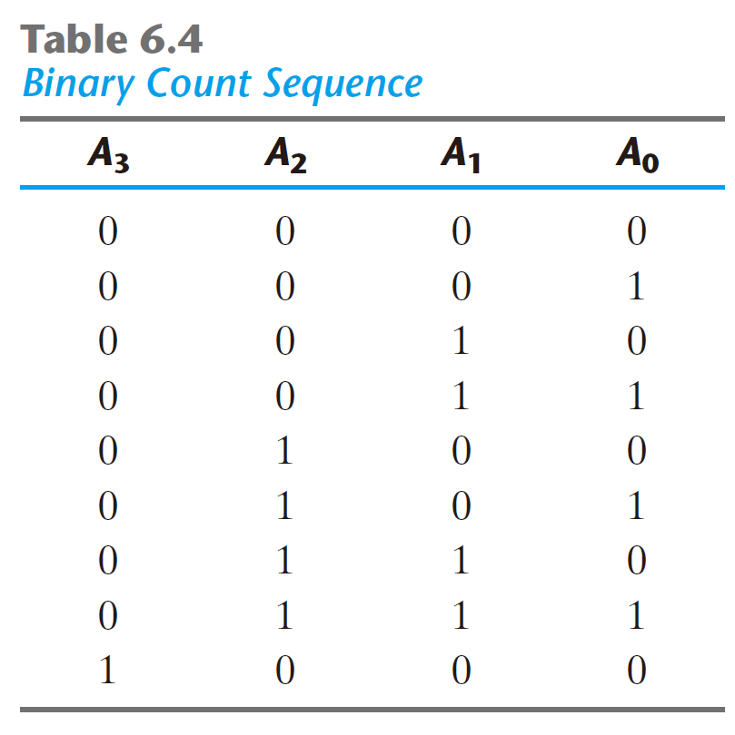
4-bit binary ripple Counter
Binary count sequence: 4-bit
An n‐bit binary counter consists of n flip‐flops and can count in binary from 0 through 2^{n} - 1.
To understand the operation of the 4‐bit binary ripple counter, refer to the first nine binary numbers listed in Table 6.4 .
After the count of 15, the counter goes back to 0 to repeat the count.
A₀ is complemented with each count pulse input.
Every time that A₀ goes from 1 to 0, it complements A₁.
Every time that A₁ goes from 1 to 0, it complements A₂.
Every time that A₂ goes from 1 to 0, it complements A₃
25

Slide 26

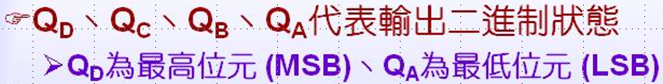
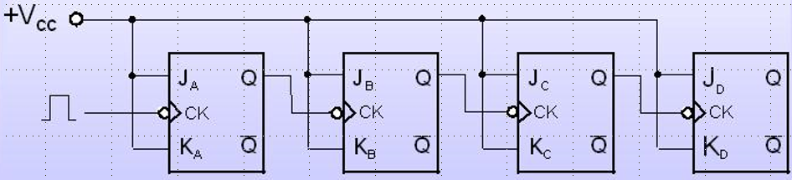
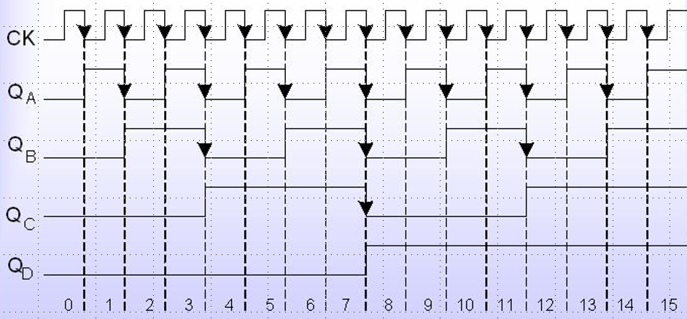

4-bit binary ripple Counters (with JK FFs)
Timing
26

Slide 27


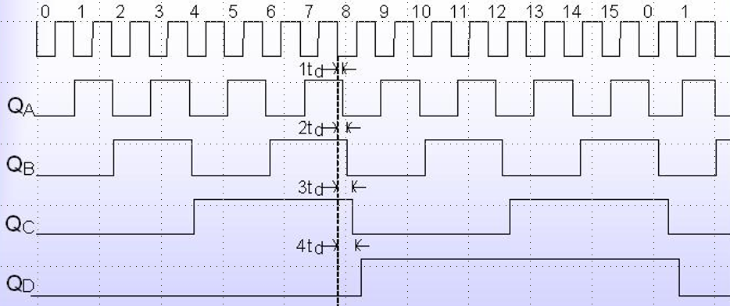
Problem with ripple Counters
27

Slide 28
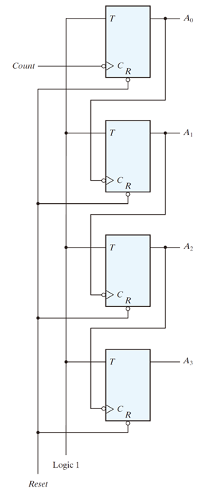
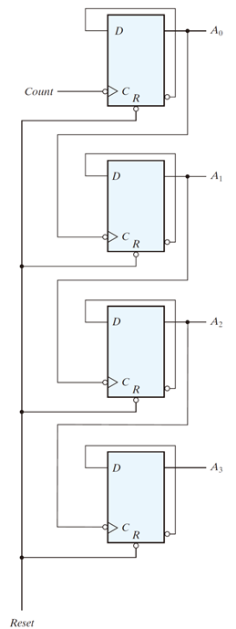
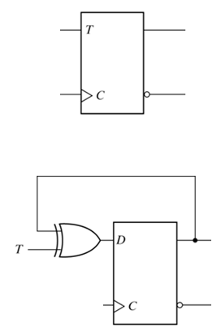
4-bit binary ripple Counters (with T and D FFs)
1
↓
↓
0
(From chap5a)
1
↓
0
=
0
↓
1
0
28

Slide 29
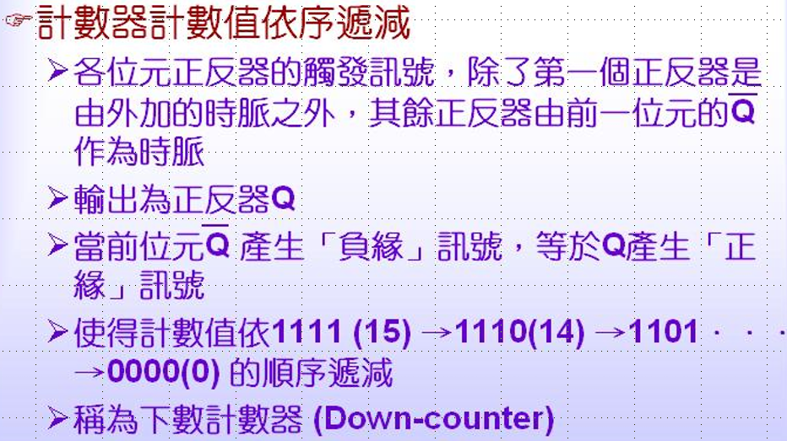
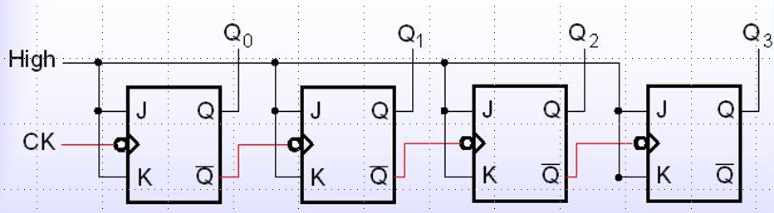
Ripple Down-Counter (with JK FFs)
29

Slide 30
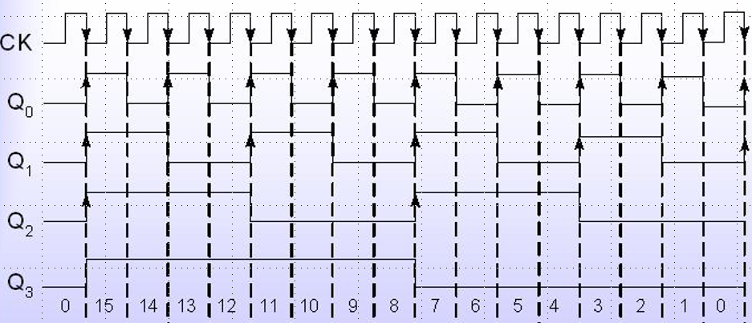
Ripple Down-Counter (with JK FFs)
30

Slide 31
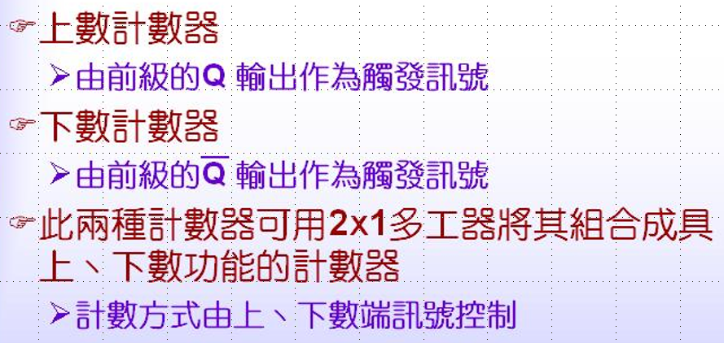
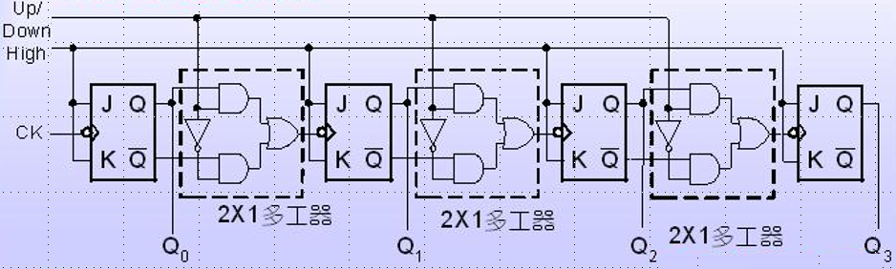
Ripple UP/Down Counter (with JK FFs)
31

Slide 32
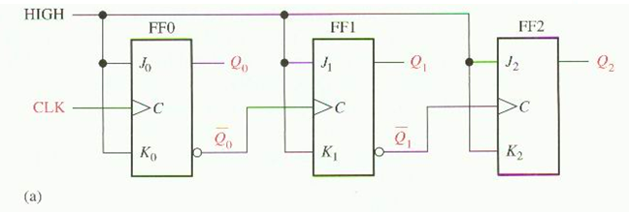
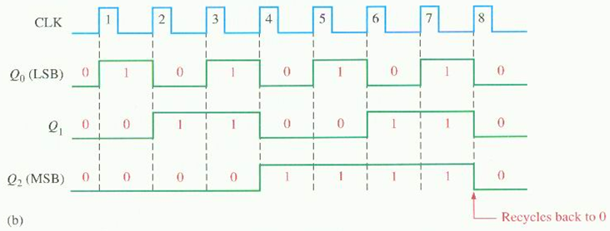
Ripple Counter (with positive edge-triggered JK FFs)
32

Slide 33
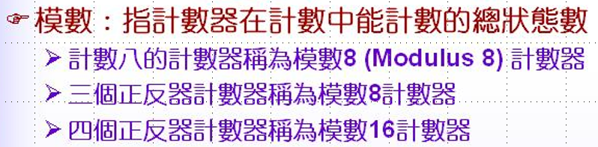
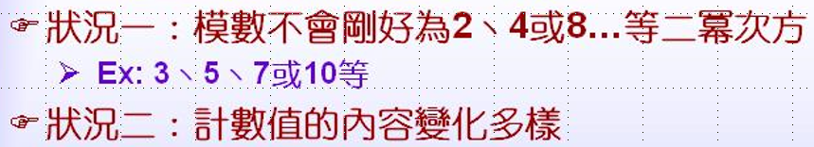


Modulo ripple Counter
33

Slide 34

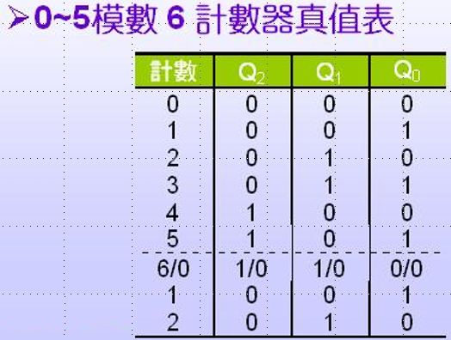
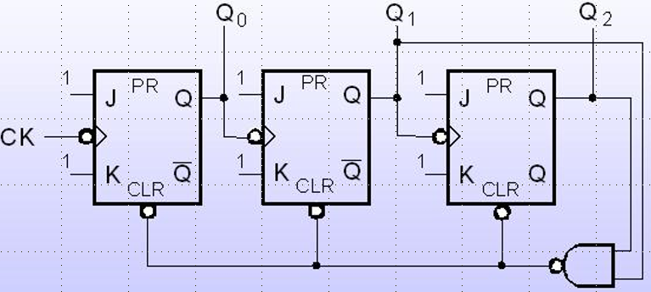

Modulo ripple Counter
34

Slide 35
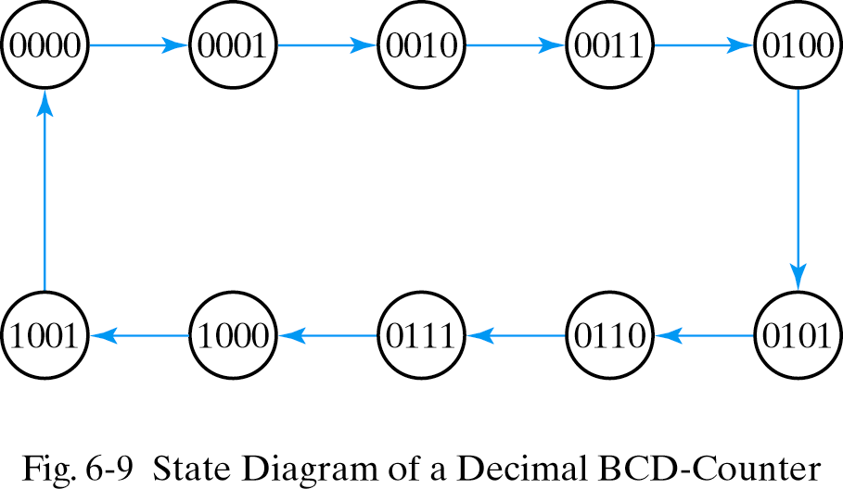
BCD Ripple Counter
Q₈
Q₄
Q₂
Q₁
0
0
0
0
0
0
0
1
0
0
1
0
0
0
1
1
0
1
0
0
0
1
0
1
0
1
1
0
0
1
1
1
1
0
0
0
1
0
0
1
0
0
0
0
35

Slide 36
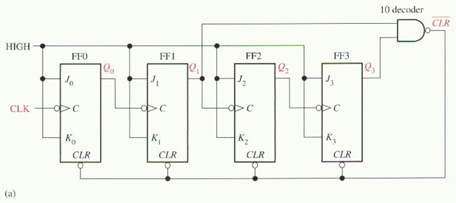
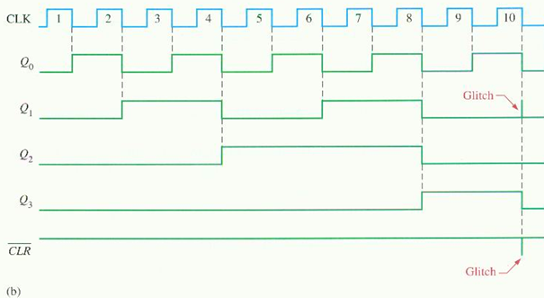
BCD Ripple Counter (method 1)
36

Slide 37
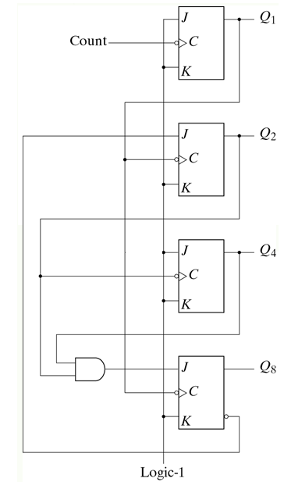
BCD Ripple Counter (method 2 from Text)
Q₁: changes state after each clock pulse
Q₄: complements every time Q₂ goes from 1 to 0.
Q₂:
When Q₈=0, Q₂ is complemented with Q₁ goes from 1 to 0.
When Q₈=1, Q₂ =0
Q₈:
When Q₂Q₄=1, Q₈ is complemented with Q₁ pulse.
Q₈ is clear when Q₂Q₄ is 0 with Q₁ pulse.
Q₈ | Q₄ | Q₂ | Q₁
0 | 0 | 0 | 0
0 | 0 | 0 | 1
0 | 0 | 1 | 0
0 | 0 | 1 | 1
0 | 1 | 0 | 0
0 | 1 | 0 | 1
0 | 1 | 1 | 0
0 | 1 | 1 | 1
1 | 0 | 0 | 0
1 | 0 | 0 | 1
0 | 0 | 0 | 0
37

Slide 38
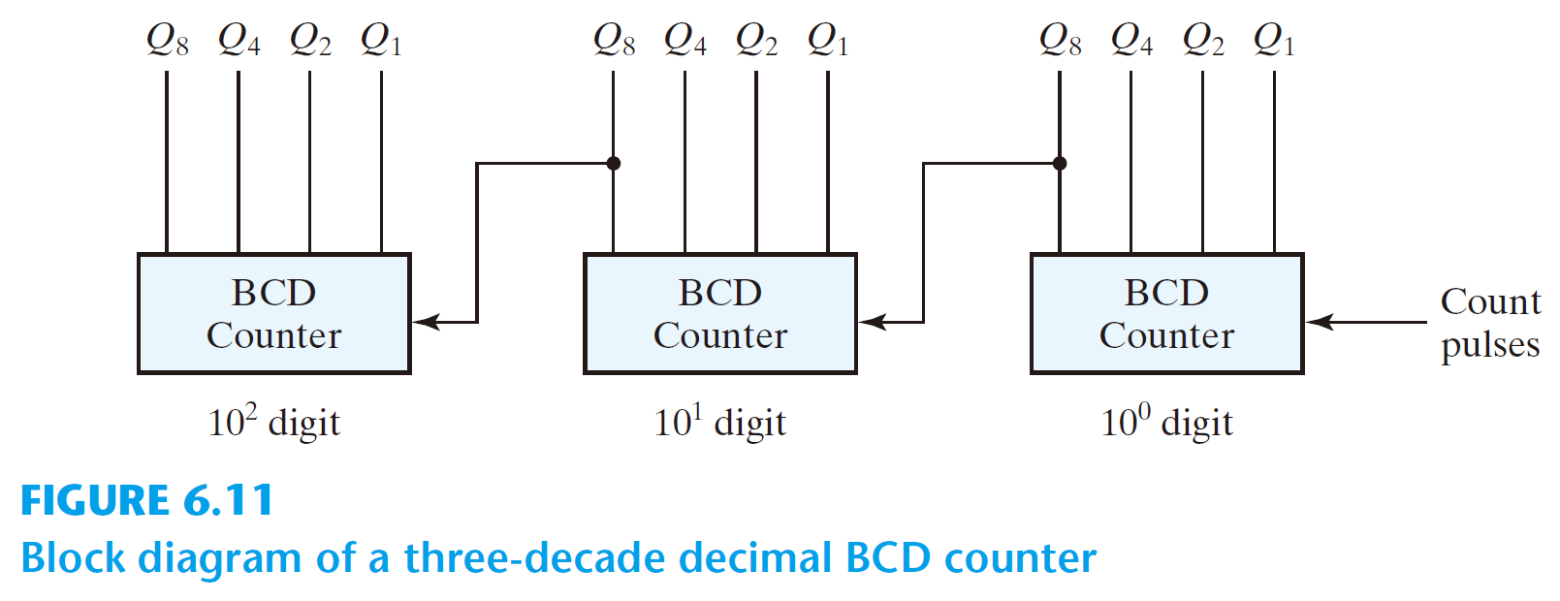
Three-Decade Decimal BCD Counter
To count from 0 to 999, we need a three‐decade counter. Multiple decade counters can be constructed by connecting BCD counters in cascade, one for each decade
When Q8 in one decade goes from 1 to 0, it triggers the count for the next higher order decade.
38

Slide 39
Synchronous Counters

Slide 40
Synchronous Counters
Synchronous counter
A common clock triggers all flip-flops simultaneously
Design procedure
apply the same procedure of synchronous sequential circuits
Synchronous counter is simpler than general synchronous sequential circuits
40

Slide 41
4-bit synchronous Binary Up-Counter
Clock cycle
Q
Q
Q
2
1
0
Q
changes
0
0
0
0
1
Q
changes
1
0
0
1
2
2
0
1
0
3
0
1
1
4
1
0
0
5
1
0
1
6
1
1
0
7
1
1
1
8
0
0
0
41

Slide 42
4-bit synchronous Binary Up-Counter (with T FFs)
1
T
Q
T
Q
T
Q
T
Q
Q
0
Q
1
Q
2
Q
3
Clock
Q
Q
Q
Q
(a) Circuit
Rules:
Q_{n} is complemented when Q_{n-1}……Q₁Q₀ =1.
Otherwise, Q_{n} has no change.
Synchronous:
All flip flops are controlled by the same clock signal.
42

Slide 43
4-bit synchronous Binary Up-Counter (with T FFs)
1
T
Q
T
Q
T
Q
T
Q
Q
0
Q
1
Q
2
Q
3
Clock
Q
Q
Q
Q
(a) Circuit
Clock
Q
0
Q
1
Q
2
Q
3
Count
0
1
2
3
4
5
6
7
8
9
10
11
12
13
14
15
0
1
(b) Timing diagram
43

Slide 44
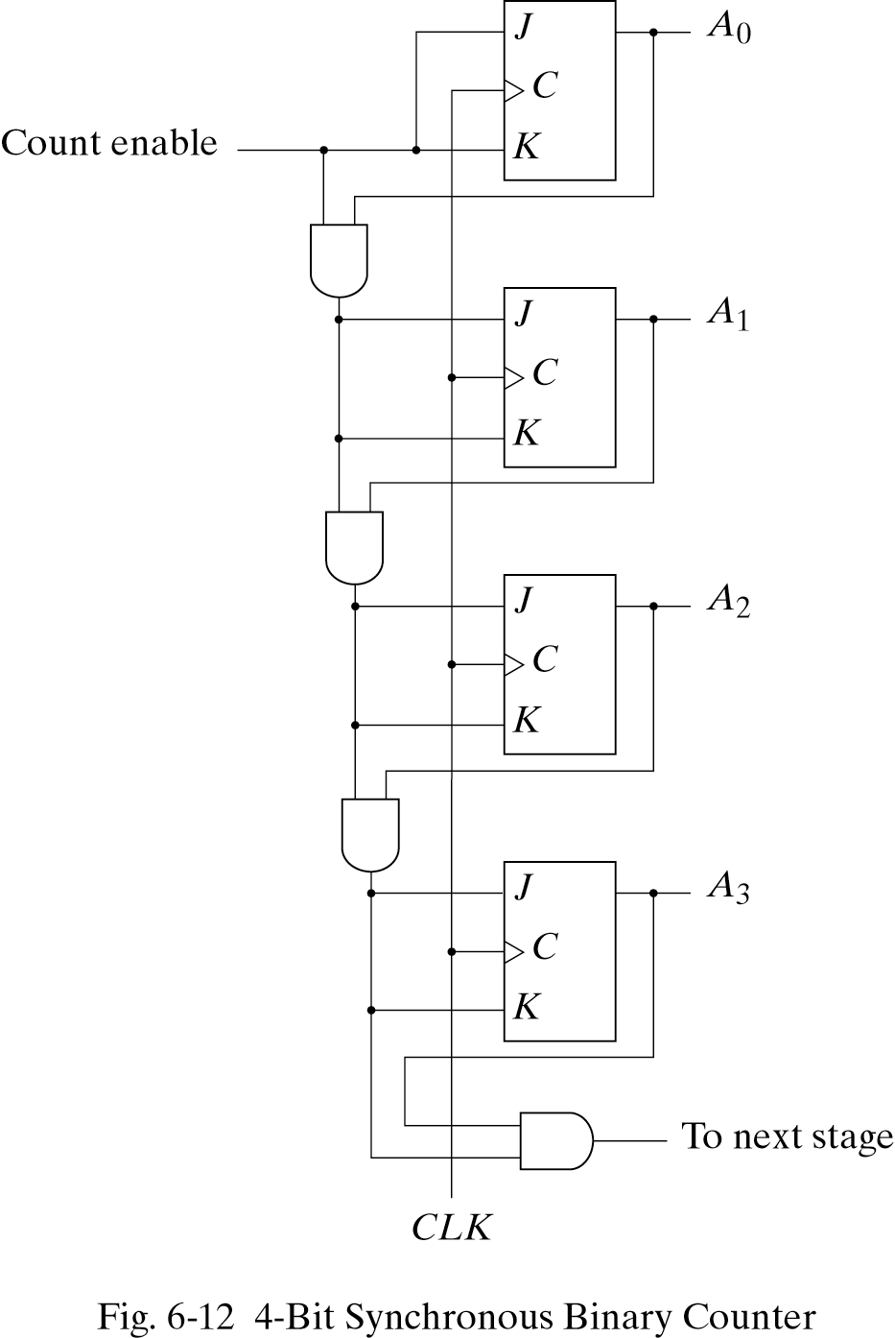
4-bit synchronous Binary Up-Counter (with JK FFs)
Synchronous counters
All of the FFs are triggered simultaneously by the clock input pulses.
All FFs change at same time
Remember
If J=K=0, flop maintains value
If J=K=1, flop toggles
Most counters are synchronous in computer systems.
Can also be made from D flops
Value increments on positive edge
44

Slide 45
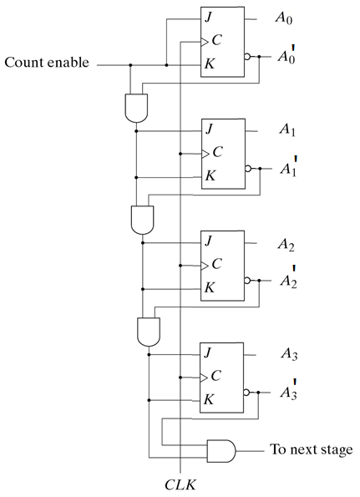
4-bit synchronous Binary Down-Counter (with JK FFs)
Down
Q₈ Q₄ Q₂ Q₁
1 1 1 1
1 1 1 0
1 1 0 1
1 1 0 0
1 0 1 1
1 0 1 0
1 0 0 1
1 0 0 0
45

Slide 46
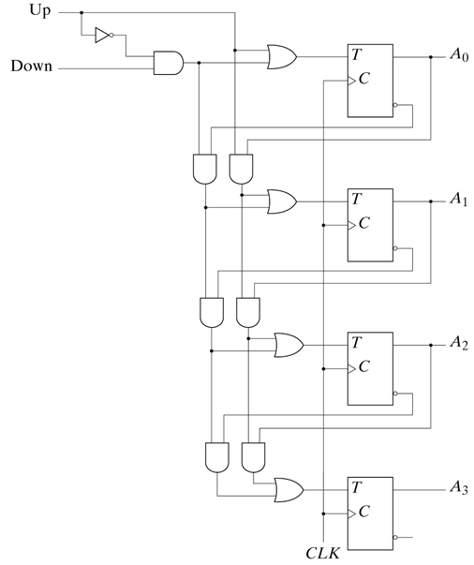
4-bit synchronous Binary Up/Down Counter (with T FFs)
Up/Down Counter can either count up or down on each clock cycle
Up counter counts from 0000 to 1111 and then changes back to 0000
Down counter counts from 1111 to 0000 and then back to 1111
Counter counts up or down each clock cycle
Output changes occur on clock rising edge
46

Slide 47
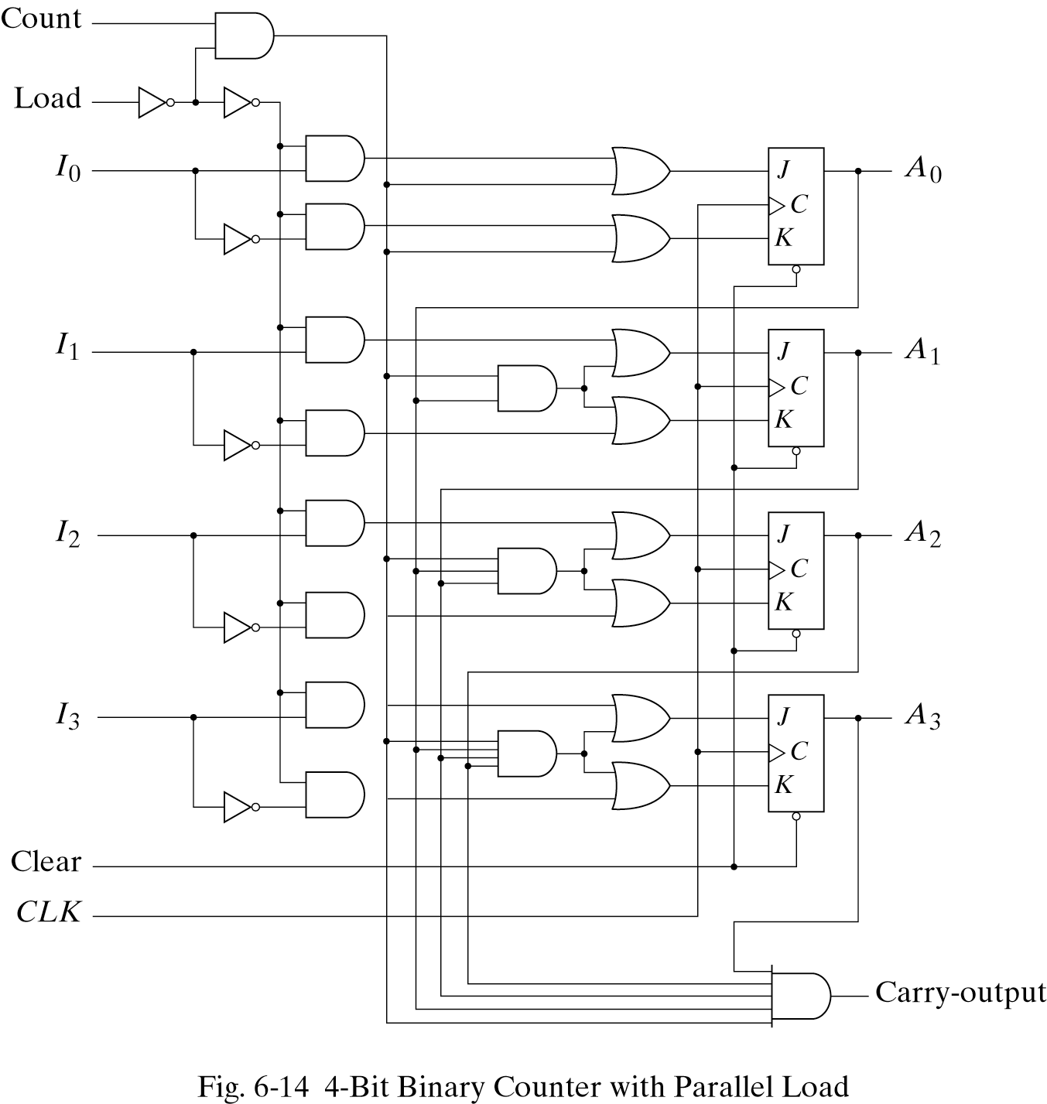
Counters with Parallel Load
Counters with parallel load can have a preset value
Load signal indicates that data (I₃…I₀) should be loaded into the counter
Clear resets counter to all zeros
Carry output could be used for higher-order bits
Clear Clk Load Count Function
0 X X X Clear to 0
1 ↑ 1 X Load inputs
1 ↑ 0 1 Count
1 ↑ 0 0 No Change
47

Slide 48
Practice Exercise
Practice Exercise 6.3
How do a ripple counter and a synchronous counter differ in their behavior?
Answer:
All of the flip-flops in a synchronous counter are synchronized by receiving a common clock pulse; only the first stage of a ripple counter receives a clock pulse.
The stages of a synchronous counter are updated simultaneous by a common clock; the stages of a ripple counter are updated one at a time.
A synchronous counter operates faster than a ripple counter.
48

Slide 49
Other Synchronous Counters

Slide 50

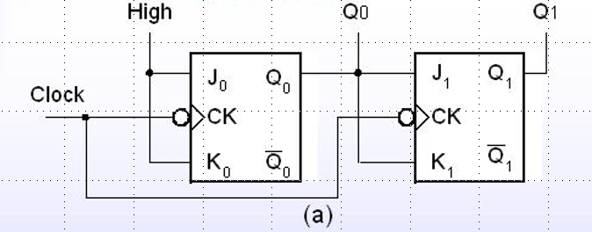

Divide-by-4 clock frequency divider
f_{Q1} = 1/4 f_{clock}
f_{Q0} = 1/2 f_{clock}
f_{Q1} = 1/2 f_{Q0}
50

Slide 51


BCD Counters Implemented by Binary Counter
Clear Clk Load Count Function
0 X X X Clear to 0
1 ↑ 1 X Load inputs
1 ↑ 0 1 Count
1 ↑ 0 0 No Change
51

Slide 52



BCD Synchronous Counter
To derive the circuit of a BCD synchronous counter, it is necessary to go through a sequential circuit design procedure.
The state table of a BCD counter is listed in Table 6.5 . The input conditions for the T flip‐flops are obtained from the present‐ and next‐state conditions. An output y which is equal to 1 when the present state is 1001.
52

Slide 53


Counter with Unused States
Consider the counter specified in Table 6-7
Two unused states: 011 & 111
J_{A} = B K_{A} = B
J_{B} = C K_{B} = 1
J_{C} = B’ K_{C} = 1
The simplified equations are
53

Slide 54

Counter with Unused States
54

Slide 55

Self Correcting
Self-correcting counter
Ensure that when a clock enter one of its unused states, it eventually goes into one of the valid states after one or more clock pulses so it can resume normal operation.
ABC=111 ➔ ABC=000
J_{A} = 1, K_{A} = 1 ➔A=0
J_{B} = 1, K_{B} = 1 ➔B=0
J_{C} = 0, K_{C} = 1 ➔C=0
ABC=011 ➔ ABC=100
J_{A} = 1, K_{A} = 1 ➔A=1
J_{B} = 1, K_{B} = 1 ➔B=0
J_{C} = 0, K_{C} = 1 ➔C=0
55

Slide 56




Ring Counter
A ring counter is a circular shift register with only one flip-flop being set at any particular time, all others are cleared.
(initial value = 1 0 0 … 0 )
The single bit is shifted from one flip-flop to the next to produce the sequence of timing signals.
56

Slide 57


Ring Counter
Application of counters
Counters may be used to generate timing signals to control the sequence of operations in a digital system.
Approaches for generation of 2^{n} timing signals
1. a shift register with 2^{n} flip-flops
2. an n-bit binary counter together with an n-to-2^{n}-line decoder
57

Slide 58



Johnson Counter
A k-bit Johnson counter will go through a sequence of 2k states.
58

Slide 59

Sequence of Timing Clock
0000
1000
1100
1110
1111
0111
0011
0001
1 0 0 0 0 0 0 0
0 1 0 0 0 0 0 0
0 0 1 0 0 0 0 0
0 0 0 1 0 0 0 0
0 0 0 0 1 0 0 0
0 0 0 0 0 1 0 0
0 0 0 0 0 0 1 0
0 0 0 0 0 0 0 1
59

Slide 60

Comparision
To generate repeated 8 different timing signals:
Using binary counter
Need a 3-bit binary counter together with a 3-to-8 decoder
Using ring counter
Need an 8-bit ring counter
Using Johnson counter
Need a 4-bit johnson counter
and simple decoding circuit
T₀
T₁
T₂
T₃
T₄
T₅
T₆
T₇
60

Slide 61
Summary
Binary counters can be ripple or synchronous
Ripple counters use flip flop outputs as flip flop triggers
Some delay before all flip flops settle on a final value
Synchronous counters are controlled by a clock
All flip flops change at the same time
Up/Down counters can either increment or decrement a stored binary value
Control signal determines if counter counts up or down
Counters with parallel load can be set to a known value before counting begins.
61
Notes:
credential:
bring a computer
die photo
wafer
:
This can be an hidden slide. I just want to use this to do my own planning.
I have rearranged Culler’s lecture slides slightly and add more slides. This covers everything he covers in his first lecture (and more) but may
We will save the fun part, “ Levels of Organization,” at the end (so student can stay awake): I will show the internal stricture of the SS10/20.
Notes to Patterson: You may want to edit the slides in your section or add extra slides to taylor your needs.

